Slide 1
Remex Architecture Document

Slide 2
Architecture Design Decision

Slide 3




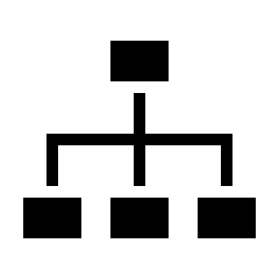



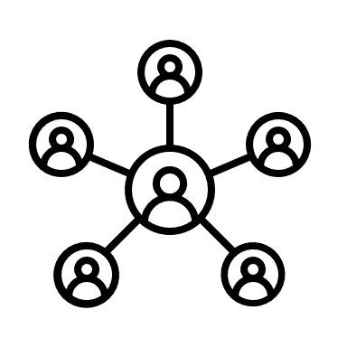
Architecture Decision Making
Choosing Service Oriented Architecture
Service Oriented
Component Based
Layered Architecture
simple interface
Ensures Reusability
Simple Framework
Input/output based
Replaceability and Reliability
Decreased Dependency
Uses Commercial Off the Shelf Products
Easy Testing
Maps application to component
Best Used for Scalable Applications
Best Used for GUI Applications
Best Used for Developing Simple Small Applications
Choosing Service Oriented Architecture
Notes:
SOA architecture allows technology and business areas to get aligned and grow closer
SOA enables the development of applications that are easier to handle and more secure, since it provides a common infrastructure and documentation to develop services, with the opportunity to add new features.
Thanks to SOA, it is possible to minimise data loss, since it offers security and high availability.
SOA architecture allows for a faster application development, in a more cost-effective manner, thanks to the flexible integration of all data.
SOA helps organizations improve their agility and flexibility

Slide 4

Technology Stack Decision Reasoning
Why Flask?
Compatible with Software Oriented Architecture
Simple, Clean Concise Code
Customizability and Flexibility
Variety of Independent Features
Lightweight and Ease of Use
Fast (Important for Trading)

Slide 5
Stakeholder Desires & Responsibilities

Slide 6
Stakeholder 1: Trader
Stakeholder Desires
Stakeholder Responsibilities
Invest in Crypto Market
Create Account/Login
Ensure Profitability
Authenticate
Select Asset
Easy to Use Interface
Select Risk Tolerance/Time Horizon
Passive Investment
Select Tradeable Amount
Start/Stop Bot

Slide 7
Stakeholder 2: Algorithm
Stakeholder Desires
Stakeholder Responsibilities
Achieve Accurate Prediction
Select Strategy based on risk tolerance/time horizon
Ensure Profitability
Maximize Profit/Minimize Loss
Minimize Risk
Access to Real-time Prices
Achieve Accurate Training
Access to Real-time trends

Slide 8
Stakeholder 3: Asset (Coin)
Stakeholder Desires
Stakeholder Responsibilities
Increase in Value
Establish its value
Become Trustworthy
Ensure Security
Provide bot with Real-time prices

Slide 9
Stakeholder 4: Bot
Stakeholder Desires
Stakeholder Responsibilities
Be provided with real-time coin values(from asset)
Ensure Ease of Use
Maximize Profit
Buy/Sell
Activate Algorithm
Ensure Algorithm Reliability
Update Asset Amount
Update User of Decisions taken
Update Algorithm Inputs

Slide 10
Stakeholder 5: Transaction
Stakeholder Desires
Stakeholder Responsibilities
Be provided with selected asset
Minimize Gas Fees
Verify user authentication
Provide records of past transactions
Ensure Security
Ensure Algorithm Reliability
Utilize Blockchain technology
Be provided with selected amount
Be provided with transaction time

Slide 11
Entity Attributes

Slide 12
Attributes - Stakeholder 1: Trader
Trader (User)
User_id int
Username string (30) [Unique]
Hashed Password string (128)
DateOfBirth string (128)
Mail string (128)
Bitcoin_Amount float
Ethrm_Amount float
BNB_Amount float
USD_Amount float

Slide 13
Attributes - Stakeholder 3: Asset (Coin)
Asset (Coin)
Coin_id int
Added_Date datatime (128)
Coin_name string (30) [Unique]
Coin_price float
Coin_price_change_1h float
Coin_price_change_24h float
Coin_volume_24h float
Coin_volume_change_24h float
Coin_market_cap float
Coin_Supply float

Slide 14
Attributes - Stakeholder 4: Bot
Bot
Bot_id int
Coin_name string (30)
Buy_percentage float
Is_active bool
User_id (foreign key references trader(user_id))

Slide 15
Attributes - Stakeholder 5: Transaction
Transaction
Transaction_id int
Buy_Coin_amount float
Sell_Coin_amount float
Added_date datetime
Buy_Coin_id (foreign key references Coin(Coin_id))
Sell_Coin_id (foreign key references Coin(Coin_id))
User_id (foreign key references Trader(User_id))
Bot_id (foreign key references Bot(Bot_id))

Slide 16
Entity Relations

Slide 17
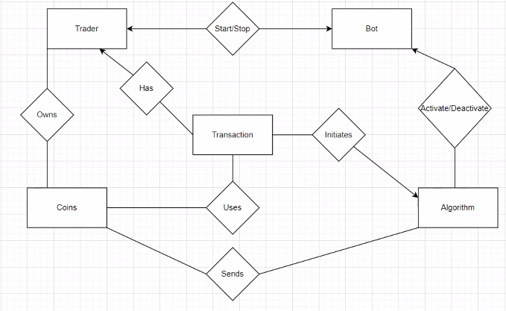
Entity Relations, ER Diagram

Slide 18
Bot Architecture Decisions

Slide 19
Front-End Overview

Slide 20
Front End Design Decisions
Key Design Principles
Executed Decisions
Minimalistic Interface
Minimal number or buttons per page
Easy to Use Interface
Easy navigation
Aesthetically pleasing and gamified experience
Well designed backgrounds and buttons
Explainability of Functionalities
Brief descriptions and Info for everything

Slide 21
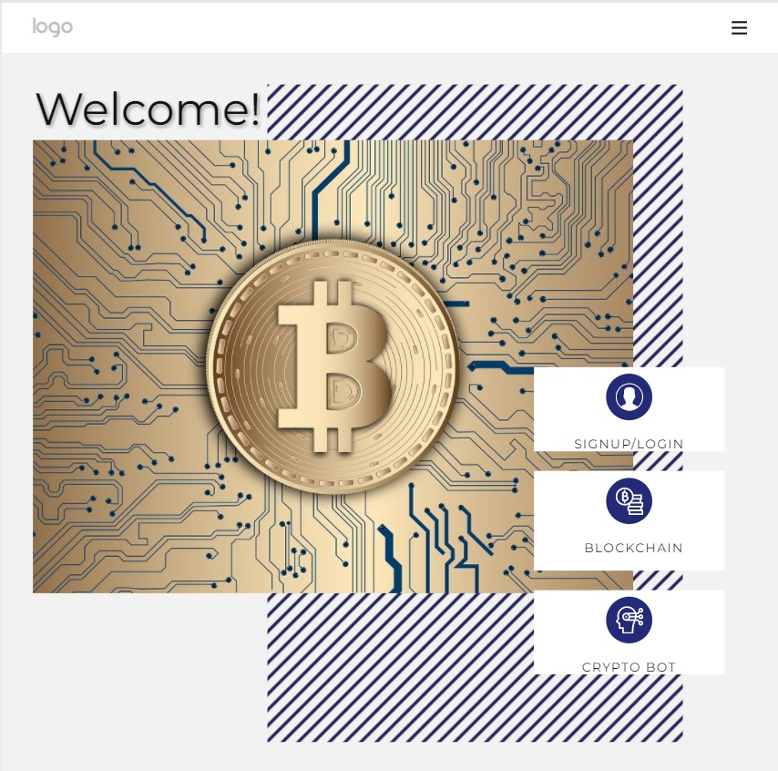
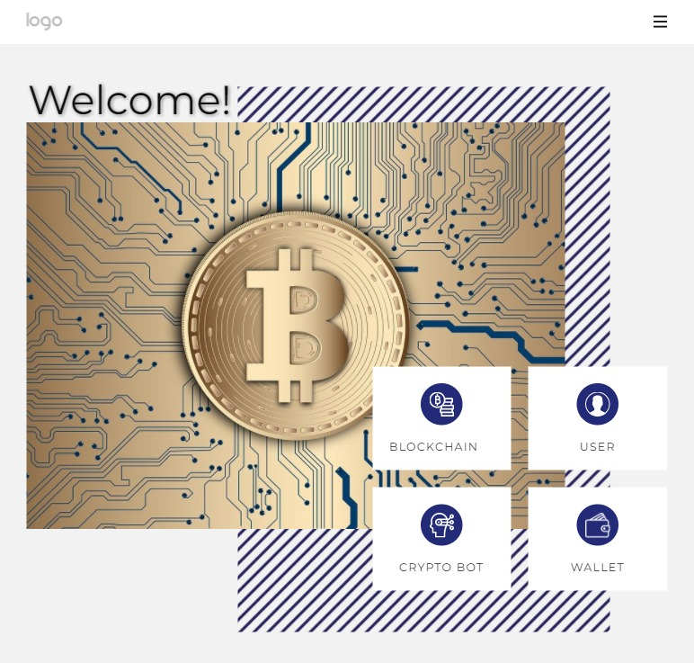
The Homepage
Not Signed In
Signed In

Slide 22
Homepage Functionality
Home Page Buttons
Blockchain Button
Shows graphs
Shows latest crypto news
Relies on Binance news
and financial info
User Button
Add personal info
Adjust Privacy settings
CryptoBot Button
Goes to portfolio if logged in
Provides brief intro of bot
capabilities if signed out
Wallet Button
Check Balance
Withdraw funds
Deposit funds
Notes:
The signed in homepage allows the user four primary functionalities.The Blockchain button opens up the Binance homepage and graph to see the latest news when it comes to crypto trading.The User button allows the user to check their privacy settings as well as add their personal information.The Crypto Bot button takes the user to the portfolio page if they're logged in and gives them a brief introduction to its capabilities if the user is not signed in.The Wallet Button allows the user to check their balance and/or withdraw/deposit funds in their wallet.

Slide 23
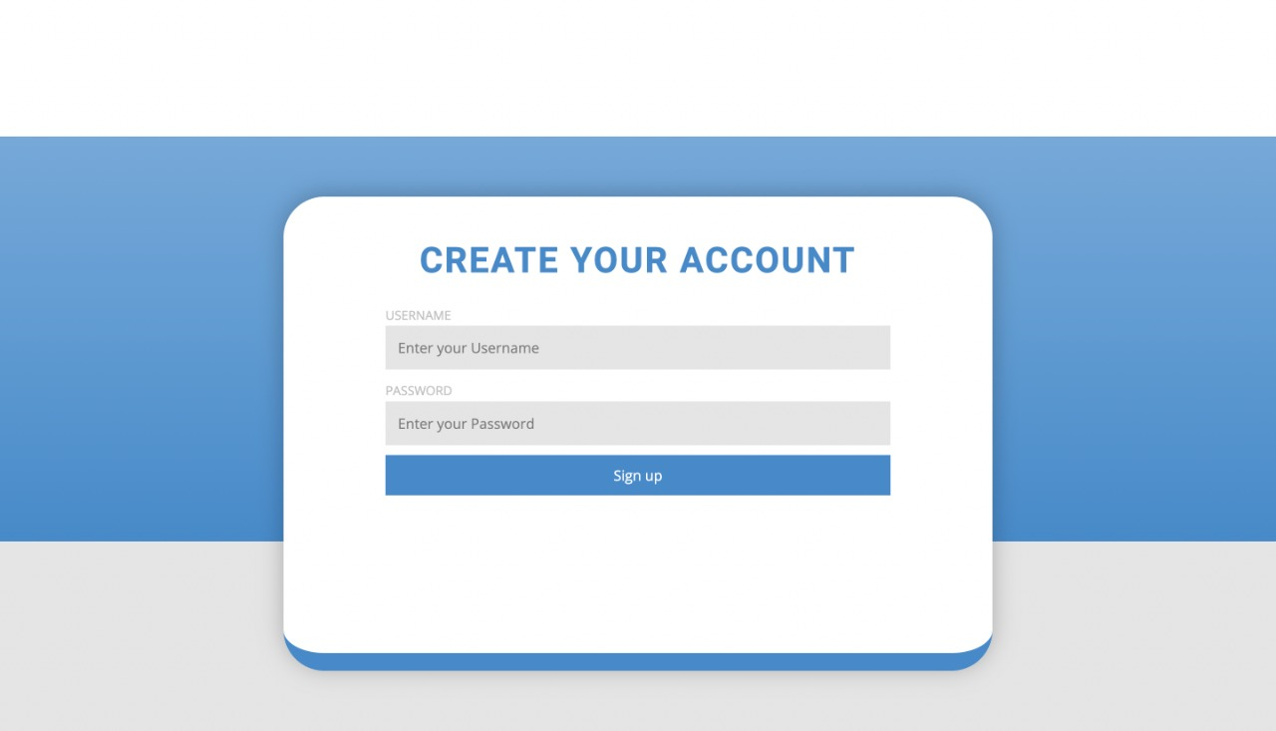
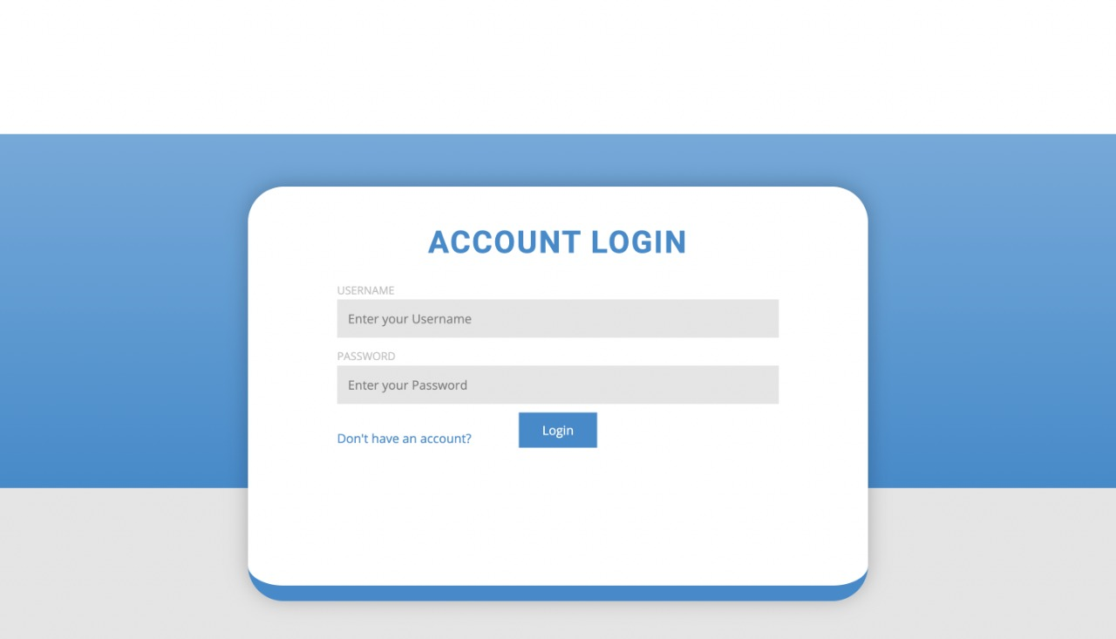
The Login/Signup Page
Sign-up
Log-In
Adapting a minimalistic design and provide user registration, verification, and authentication for all users
of the service. Also provides a forgot password functionality for account restoration using alternative
verification methods (Phone Number, Personal Question, Email…)

Slide 24
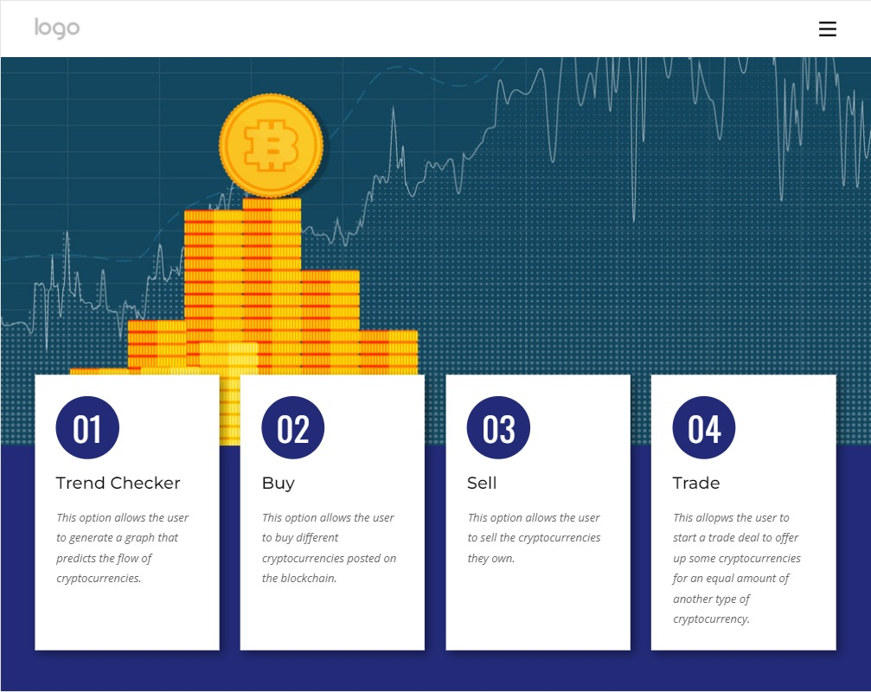
The Portfolio Page
Design
Overview
Provides access to trend checker to show users trade data and projections by generating trend graphs
Provides access to the buy functionality to purchase crypto assets using stablecoins or through bank transfer
Provides access to the sell functionality to sell off cryptocurrency assets in exchange for stable coins
Provides access to the trade functionality to allow users to trade their crypto coins for other crypto coins

Slide 25
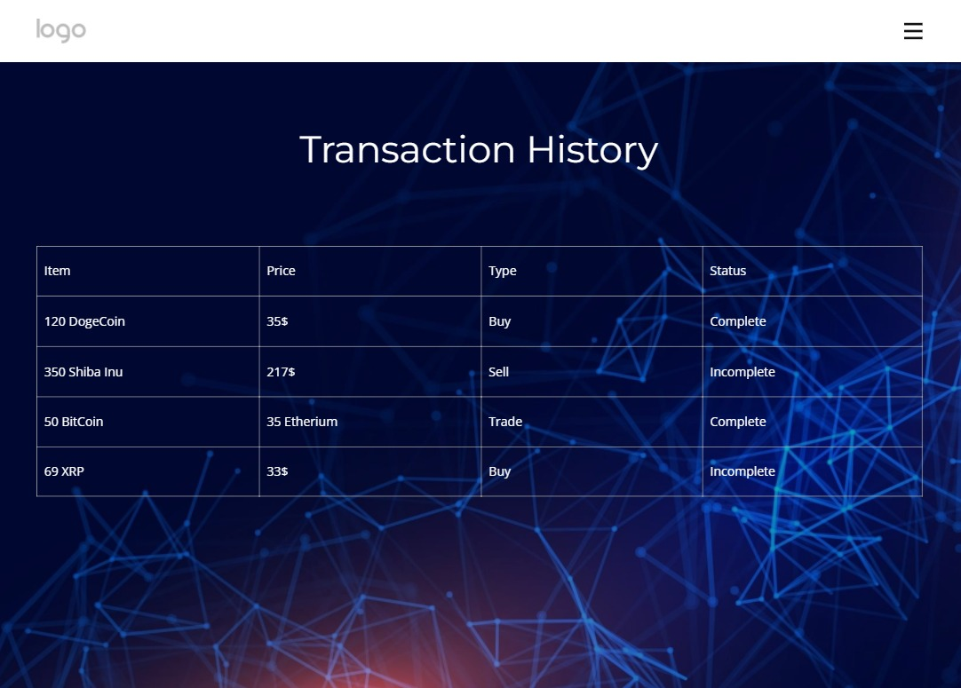
The Transactions Page
Design
Overview
Keeps detailed records regarding activity history
Shows type of coins purchased
Shows number of coins purchased
Shows Dollar Amount equivalent for coins purchased
Shows trade status (Complete/Incomplete) based on if the trade order has been closed

Slide 26
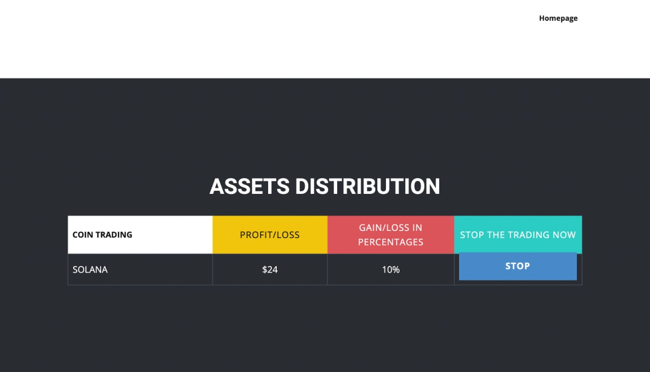
The Asset Distribution Page
Design
Overview
Provides an overview of all currently purchased assets by the bot and the user
Allows for a stop bot functionality to halt trading the coin incase the user decides against it
Displays profit and loss in $ equivalent
Displays Gain/Loss Percentages since trade open

